Slide 1
Topic: Algebra EQ: How do we solve Equations when there are unknowns on both sides?
Year 8 Mathematics
Mrs Parlevliet

Slide 2
Contents
Glossary or Formula Page
Page
Date
Essential Question
24
7
30
Word or Formula
Definition or Example

Slide 3
Tasks
24
7
30
Topic
Essential Question
Questions
Notes
Summary
1
2

Slide 4
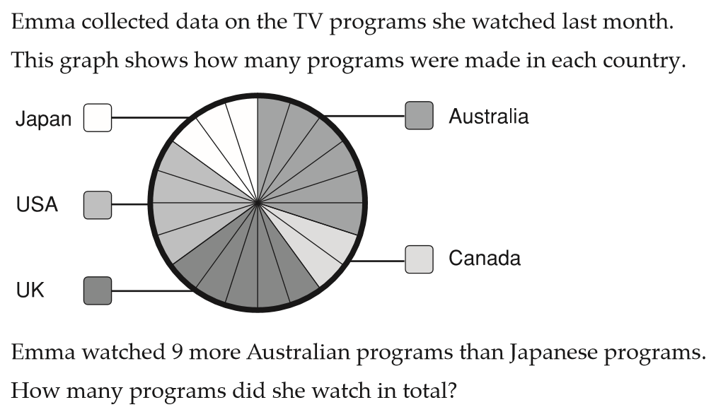

Five Questions (LHS)
Topic: Algebra
Date: xx/xx/2019
EQ – How do we solve equations when there are unknowns on both sides?
If $6x+3=21$, what is the value $x$?
If $4r=20$, what would $9r$ be equal to?
Simplify the expression, $2x+5(x−2)$
What is another way of writing the equation $3x+8=7x+12$?

Slide 5
Collaborative Study Group
WICOR
You will be working with the people sitting next to you.
You will be working together to solve an equation.
Your group must commit to an answer and agree with how you got to your answer.
On your mini-whiteboards, write your group’s answer and the steps taken to get to your answer.
A Gallery Walk will take place after followed by a whole class discussion
Notes:
Emphasise the key point of always performing the same operation to both sides of an equation when solving for an unknown.

Slide 6
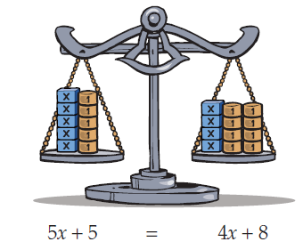

Solve $5x+5=4x+8$

Slide 7
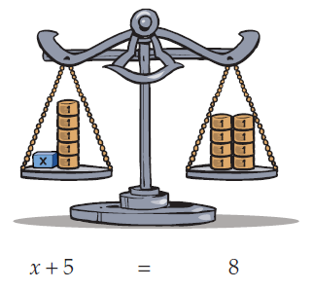
Solve $5x+5=4x+8$

Slide 8
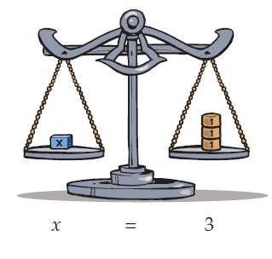
Solve $5x+5=4x+8$

Slide 9
24
7
30
WICOR
Topic: Algebra
Date: XX/XX/2019
EQ: How do we solve equations when there are unknowns on both sides?
What are the steps that I need to take to solve for a variable that is on both sides of the equal sign?
The aim is to have the variable on one side of the equal sign by itself with a number on the other side.
You always need to perform the same operation to both sides of an equation.
To “undo” an operation you need to perform the inverse operation on both sides of the equation.
You need to “undo” the inverse operations in reverse order of BIMDAS.

Slide 10

Solve for the Unknown Variable (I Do: You Listen and watch me)
WICOR
$$7c+2=6c−5$$

Slide 11

Solve for the Unknown Variable (WE Do: You Listen and write)
WICOR
$$4b+1=2b−15$$

Slide 12

Solve for the Unknown Variable (YOU DO: Your Turn, ask for help if you need to)
WICOR
$$3a−5=a+7$$

Slide 13
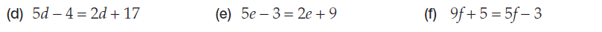
Task 1: Solve for the unknown variable

Slide 14
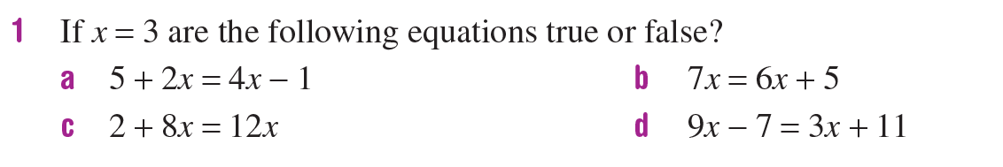
Task 2: Complete these Questions

Slide 15
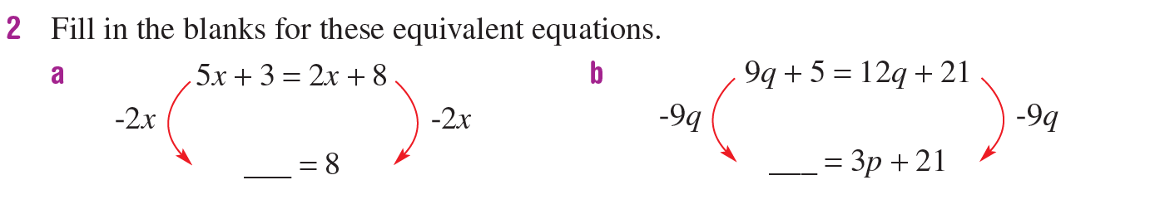
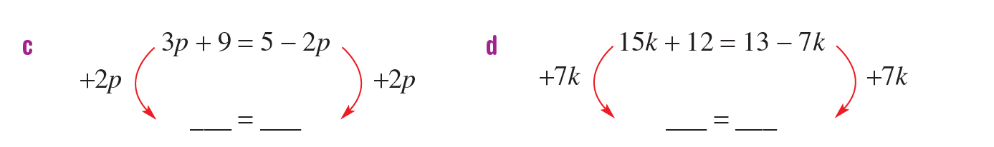
Task 2: Complete these Questions

Slide 16
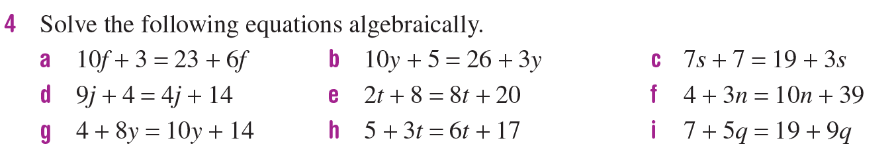
Task 2: Complete these Questions

